Slide 1

Coca Cola Company
Group name:

Slide 2
General, relevant market information
Systematic factors that influence the stock price
FED rate: average (4.75%), won’t impact stock too much, not low enough to be considered
beneficial
Economic growth: environment creates both risks and opportunities for Coca-Cola stock
Political issues: can be risky because Coca-Cola's demand is worldwide + supply chain is global, so
need to be careful about political instability which may disrupt demand/supply
Consumer behaviour: strong brand, stable demand, staple product for households, reliable
Unemployment: High unemployment can lead to decreased consumer spending as people prioritize essential goods
Inflation: If inflation rises, Coca-Cola may need to increase prices, potentially impacting sales volumes. However, strong brand loyalty may help mitigate this effect.

Slide 3
Business overview
Company background, qualitative analysis
How do they make money (sources of revenue): soft drinks + has expanded its portfolio to include healthier options, global distribution
Who are their customers: individuals and families across various demographics, sold through
various retail channels (supermarkets, households, restaurants, convenience stores,…)
Business model: operates through a franchise system, where it sells concentrate and syrup to bottling partners, who then produce, package, and distribute the finished products.
positive/negative news:
Other factors to consider: m&a, dividends, regulation: actively seeks M&A opportunities to diversify its portfolio and enhance market presence, known for its reliable dividend payments,
health regulation may impact marketing strategies

Slide 4
SWOT
Porter forces
Strengths:
Strong global brand recognition.
Extensive distribution network.
Diverse product portfolio, including health-conscious
options.
Weaknesses:
Dependence on carbonated beverages, which face declining consumption trends.
Vulnerability to fluctuations in commodity prices
(e.g., sugar, aluminum).
Opportunities:
Expansion into emerging markets.
Continued innovation in healthier beverage choices.
Strategic partnerships and acquisitions to enhance product offerings.
Threats:
Increasing health regulations and sugar taxes.
Intense competition from other beverage
companies and local brands.
Economic uncertainty affecting consumer spending.
Threat of New Entrants: Moderate; significant barriers to entry exist due to brand loyalty and distribution networks.
Bargaining Power of Suppliers: Low; Coca-Cola relies on a large number of suppliers, reducing individual supplier power.
Bargaining Power of Buyers: Moderate; while consumers have choices, Coca-Cola's strong brand loyalty can mitigate this power.
Threat of Substitutes: High; consumers can easily switch to alternative beverages, including water, teas, and energy drinks.
Industry Rivalry: High; the beverage industry is highly competitive, with major players like PepsiCo and Nestlé.

Slide 5
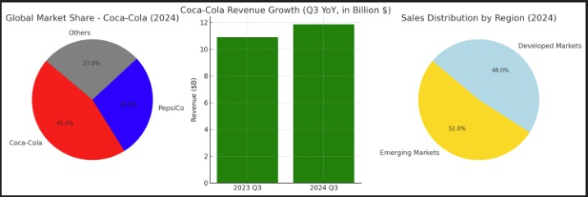
Industry Performance
1. Industry Overview
Sector: Non-alcoholic beverages.
Industry growth: The global beverage market is growing steadily, driven by demand for health-conscious products and expanding markets in Asia and Latin America. Coca-Cola benefits from its broad portfolio of sparkling and non-sparkling beverages
2. Market Share
Coca-Cola holds the largest share of the global soft drinks market, estimated at around 45% in 2024. It has strong dominance across regions, particularly in Latin America and Asia
3. Competitive Landscape
Market structure: Oligopolistic, shared with PepsiCo and a few regional players.
Competitive pressure: Moderate to high, driven by
increasing demand for healthier alternatives and localized beverage companies. Coca-Cola maintains an edge through aggressive branding and product diversification
4. Financial Position
Q3 2024 Revenue: $11.85 billion, up 9% YoY, driven by pricing adjustments and strong performance in emerging markets Coca-Cola Company
tickergate
Unit Volume Growth: Up 2% globally, led by mid-single-
digit growth in developing markets (e.g., India, Brazil)
5. Positioning
Coca-Cola is leveraging technology and packaging innovation to maintain affordability and reach new markets, especially in Asia and Latin America. Its premium offerings, like Coke Zero Sugar, are seeing consistent growth, up 6% YoYCoca-Cola Company

Slide 6
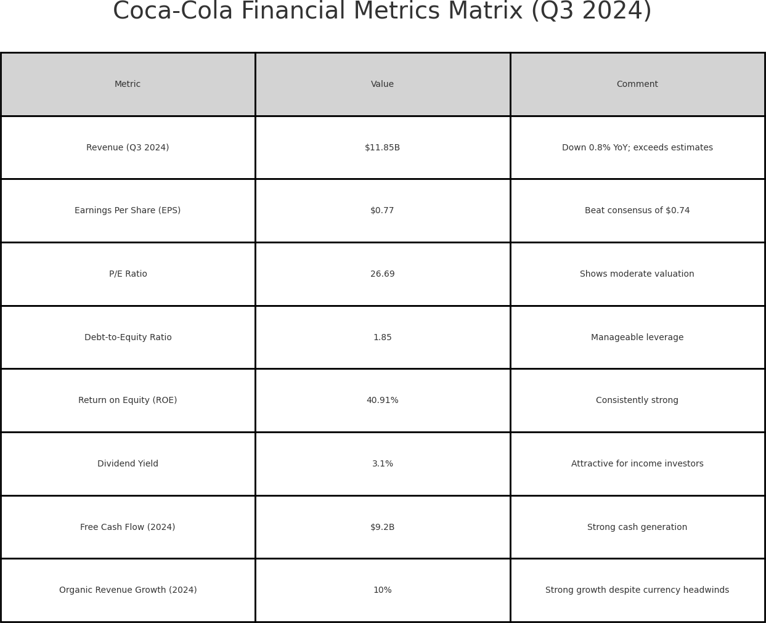
Fundamentals
Revenue and Earnings
Revenue: $11.85 billion, down 0.8% YoY, but exceeds estimates of $11.61 billion.
EPS: $0.77, beats consensus of $0.74, indicating strong profitability.
Valuation Metrics
Trailing EPS: $2.42, demonstrating steady earnings.
P/E Ratio: 26.69, reflecting a moderate valuation for a blue-chip stock.
Financial Ratios
Debt-to-Equity Ratio: ~1.85, showing manageable leverage levels.
Return on Equity (ROE): ~40.91%, highlighting excellent shareholder
returns.
Dividend Yield: ~3.1%, making it attractive for income-focused investors.
Debt Management
Free Cash Flow: $9.2 billion expected in 2024, supported by disciplined
capital expenditures of $2.2 billion.
Growth Guidance
EPS Growth (2025): 5-6%, projected increase to $2.96.
Organic Revenue Growth (2024): ~10%, with currency headwinds
impacting results.
YoY Highlights
Revenue decreased slightly by 0.8% YoY, while EPS rose by 11.6%,
showing profitability improvements despite minor revenue decline.
Free Cash Flow increased by 4.5%, reinforcing operational efficiency.
Dividend yield grew from 2.9% to 3.1%, enhancing investor returns.

Slide 7
Discounted cash flow model
Next time!

Slide 8
Comparables
Next time

Slide 9
Technical Analysis
Only if applicable
Indicators, trend lines, support lines
Fibonacci levels, oscillators

Slide 10
Risk
Risks:
1)Declining Volume in Key Market:
Coca-Cola’s Q3 2024 results showed a decline in unit case volumes in major markets such as China, Mexico, and Turkey. These regions are critical for revenue growth, and consistent volume declines could signal weakening brand strength or demand saturation in those markets.
2)CEO Share Sale Impact on Sentiment:
CEO James Quincey’s recent sale of 100,000 shares might undermine investor confidence, especially during a period when Coca-Cola faces operational headwinds. Insider selling by the CEO is often viewed as a potential red flag for near-term stock performance, regardless of personal motives.
3)Growing Debt Burden:
Coca-Cola’s leverage remains high, with total debt levels increasing over the past few years. Rising interest rates globally could make refinancing debt more expensive, pressuring free cash flow and net earnings.
4)Overvaluation Concerns:
Coca-Cola’s high price-to-sales (P/S) ratio relative to competitors like PepsiCo makes the stock vulnerable to a correction if earnings growth slows. Investors may view Coca-Cola as overpriced, leading to reduced demand for the stock.
5)Other(non-relevant as Coca Cola operates so many years and faced these problems before, we invest for short-run these risks are for long-run)
Regulations about plastics-Environmental backlash
Higher taxes for sugar
Shift towards healthier options

Slide 11
Proposal and Exit strategy
Analysts forecast moderate price appreciation, with Coca-Cola having a price target of $72.36, suggesting a 15% upside. Coca-Cola’s Q4 2024 earnings report is scheduled for February 2025. As for Q1 2025, the earnings report is anticipated to be released in April 2025. The 2025 first dividend payment will likely take place around April 2025 . These reports and the dividend payments are key events that can impact the stock price.
We are considering an exit strategy that we hold the stock through the Q4 report to capture any earnings momentum, and then consider exiting before or after the Q1 earnings in April—especially if the market is likely to price in strong performance and favorable guidance for the full year.
Proposal:
Buy on 17th of December, the day after the dividend payment when the price is going to be low as many investors sell the stock.
Sell:
1. On February 2025, before or after the Q4 2024 Earnings as the price of the stock will be high.
2. If the price hits 73$.
3. On April 2025, after the Q1 2025 Earnings and the dividend payment, as the price of the stock will be high.
Invest:
Invest (15%)20% of our portfolio, selling (5%)10% when it achieves 10% growth, and holding the remaining 10% until exit date.

Slide 12

Thank you.

